Slide 1
Unit 4
Cryptographic Hash Functions and Digital Signatures

Slide 2
Message Authentication
Message authentication is a mechanism or service used to verify the integrity of a message.
Message authentication assures that data received are exactly as sent (i.e., there is no modification, insertion, deletion, or replay).
In many cases, there is a requirement that the authentication mechanism assures that purported identity of the sender is valid.
When a hash function is used to provide message authentication, the hash function value is often referred to as a message digest.

Slide 3
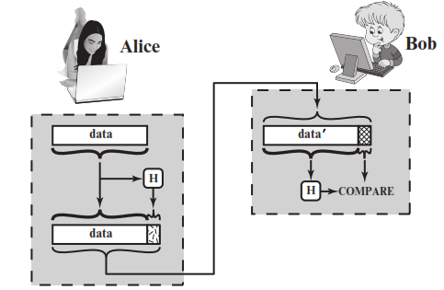
Message Digest

Slide 4
Message Digest
The sender computes a hash value as a function of the bits in the message and transmits both the hash value and the message. The receiver performs the same hash calculation on the message bits and compares this value with the incoming hash value.
If there is a mismatch, the receiver knows that the message (or possibly the hash value) has been altered.

Slide 5
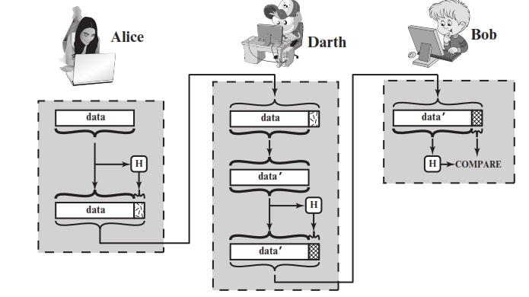
Insecure Hash Transmission

Slide 6
Insecure Hash Transmission
The hash value must be transmitted in a secure fashion, so that it is not feasible for adversary to also alter the hash value to fool the receiver.
In the example in previous slide, Alice transmits a data block and attaches a hash value. Darth intercepts the message, alters or replaces the data block, and calculates and attaches a new hash value. Bob receives the altered data with the new hash value and does not detect the change. To prevent this attack, the hash value generated by Alice must be protected.

Slide 7
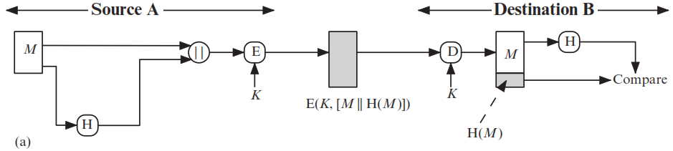
Usage of Hash in Message Authentication

Slide 8
Usage of Hash in Message Authentication
a) The message plus concatenated hash code is encrypted using symmetric encryption. Because only A and B share the secret key, the message must have come from A and has not been altered. The hash code provides the structure or redundancy required to achieve authentication. Because encryption is applied to the entire message plus hash code, confidentiality is also provided.

Slide 9
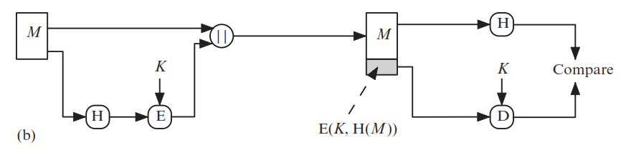
Usage of Hash in Message Authentication

Slide 10
Usage of Hash in Message Authentication
b) Only the hash code is encrypted, using symmetric encryption. This reduces the processing burden for those applications that do not require confidentiality.

Slide 11
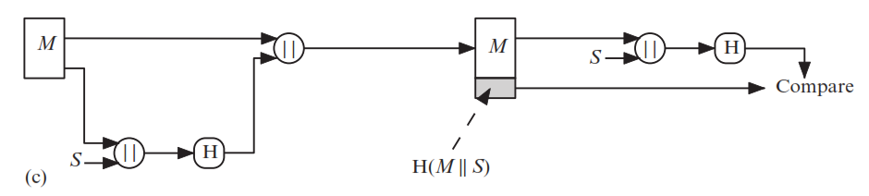
Usage of Hash in Message Authentication

Slide 12
Usage of Hash in Message Authentication
c) It is possible to use a hash function but no encryption for message authentication. The technique assumes that the two communicating parties share a common secret value S. A computes the hash value over the concatenation of M and S and appends the resulting hash value to M. Because B possesses S, it can re-compute the hash value to verify. Because the secret value itself is not sent, an opponent cannot modify an intercepted message and cannot generate a false message.

Slide 13
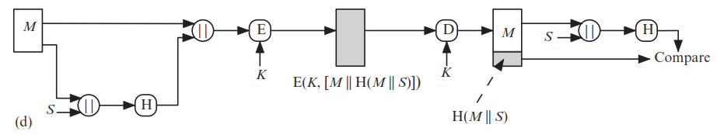
Usage of Hash in Message Authentication
Confidentiality can be added to the approach of method (c) by encrypting the entire message plus the hash code.
When confidentiality is not required, method (b) has an advantage over methods (a) and (d), which encrypts the entire message, in that less computation is required.

Slide 14
Message Authentication Functions:
Any message authentication mechanism has two levels of functionality:
At the lower level, there must be some sort of function that produces an authenticator: a value to be used to authenticate a message.
This lower-level function is then used as a primitive in a higher-level authentication protocol that enables a receiver to verify the authenticity of a message.

Slide 15
Message Authentication Functions:
There are three types of functions that may be used to produce an authenticator:
Hash function: A function that maps a message of any length into a fixed- length hash value, which serves as the authenticator.
Message encryption: The cipher text of the entire message serves as its authenticator.
Message authentication code (MAC): A function of the message and a secret key that produces a fixed-length value that serves as the authenticator.

Slide 16
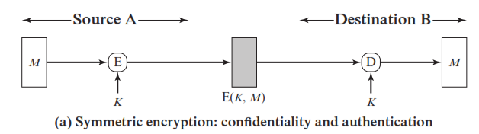
Message Encryption
Message encryption by itself can provide a measure of authentication. The analysis differs for symmetric and public-key encryption schemes.

Slide 17
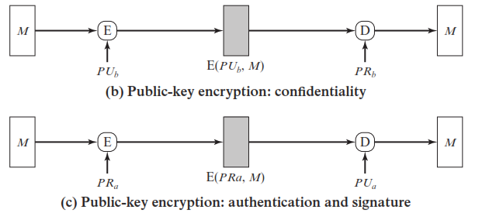
Message Encryption

Slide 18
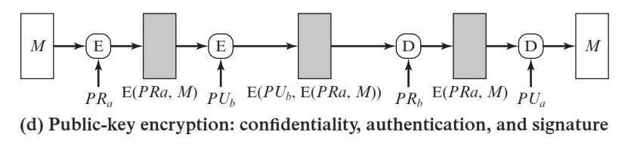
Message Encryption

Slide 19
Message Authentication Code (MAC)
A authentication technique that involves the use of a secret key to generate a small fixed-size block of data that is appended to the message is known as Message Authentication Code (MAC).
This technique assumes that two communicating parties, say A and B, share a common secret key K.

Slide 20
Message Authentication Code (MAC):
When A has a message to send to B, it calculates the MAC as a function of the message and the key:
MAC = C (K, M)
where,
M = input message
C = MAC function
K = shared secret key
The message plus MAC are transmitted to the intended recipient. The recipient performs the same calculation on the received message, using the same secret key, to generate a new MAC. The received MAC is c.ompared to the calculated MAC

Slide 21
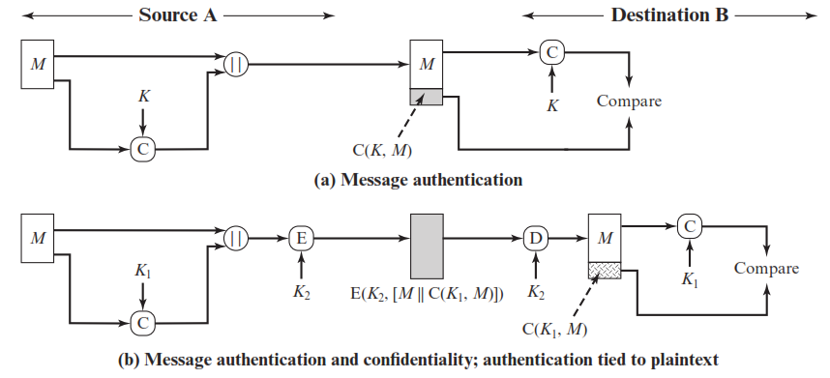
Message Authentication Code (MAC)

Slide 22
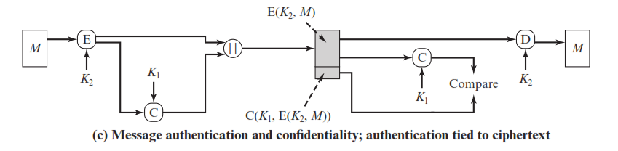
Message Authentication Code (MAC)

Slide 23
Cryptographic Hash Function
It is a mathematical algorithm that maps data of arbitrary size (often called the "message") to bit string of a fixed size (the "hash value", "hash", or "message digest") and is a one-way function that is, a function which is practically infeasible to invert.
Ideally, the only way to find a message that produces a given hash is to attempt a brute-force search of possible inputs to see if they produce a match, or use a table of matched hashes.

Slide 24
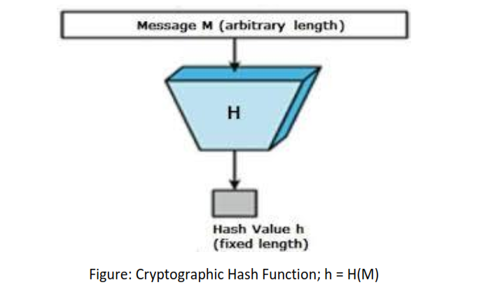
Cryptographic Hash Function

Slide 25
Properties of Hash Function
it is deterministic, meaning that the same message always results in the same hash
it is quick to compute the hash value for any given message
it is infeasible to generate a message that yields a given hash value (Pre-Image Resistant)
it is infeasible to find two different messages with the same hash value (Collision Resistance)
A small change to a message should change the hash value so extensively that the new hash value appears uncorrelated with the old hash value (avalanche effect)

